Slide 1
DH: Introduction

Slide 2
Welcome

Slide 3
Introductions
You:
I: A. Bolintineanu (BOH-LYNN-TEE-NYAH-NOO), Digital Medieval Studies

Slide 4
Today
Intro
What is DH?
A partial history
Project examples
Course syllabus

Slide 5
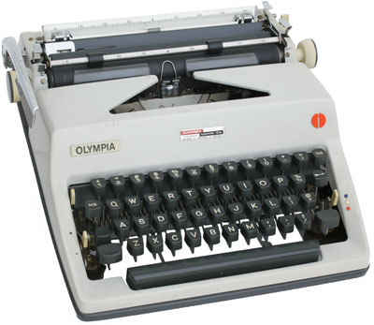
Olympia SM-9 De Luxe (1970). Mr. Martin’s Website: The Typewriter Museum. http://www.mrmartinweb.com/type.htm#olympia

Slide 6
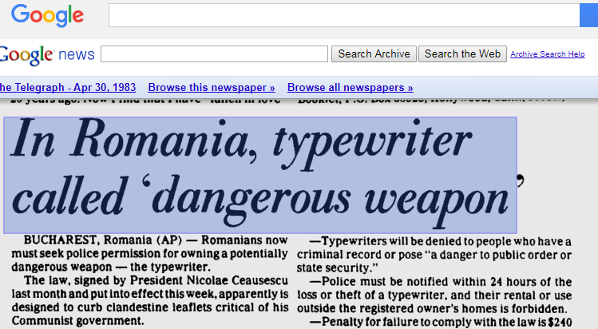
The Telegraph, April 30, 1983.

Slide 7
Digital Humanities (DH)

Slide 8
Overview

Slide 9
Digital Humanities (DH)
DH: at the fluctuating intersections of the humanities with computing
Humanities
Computing Tools & Methodologies

Slide 10
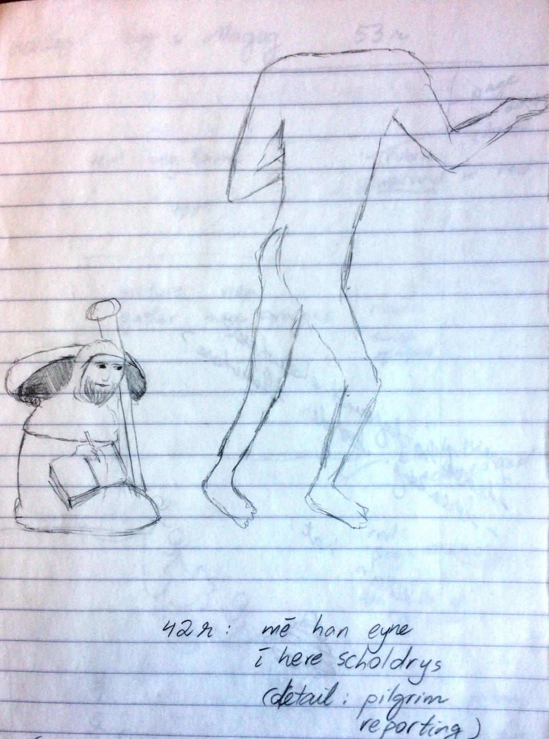
British Library, MS. Harley 3954. The Book of John Mandeville.
(my sketch, c. 2007)
Notes:
Digital archives provide access to material that may be housed far from a scholar’s physical location. Ten years ago, I had to travel to the British Library to work with their medieval manuscripts. (Incidentally, I still have the sketches I made of their illumination. In pencil, because you can’t take pens into the reading room.) I got to handle a fourteenth-century manuscript, its parchment pages as supple, its illuminations as vivid as the day the book was scribed. I sat in the special collections library for seven hours. I looked at the illuminations; I handled the parchment, noting the differences between hair side and flesh side (parchment is made of animal skin, so you can see which side faced the outside and which faced the inside of the animal). For days, my hands smelled like goat.

Slide 11
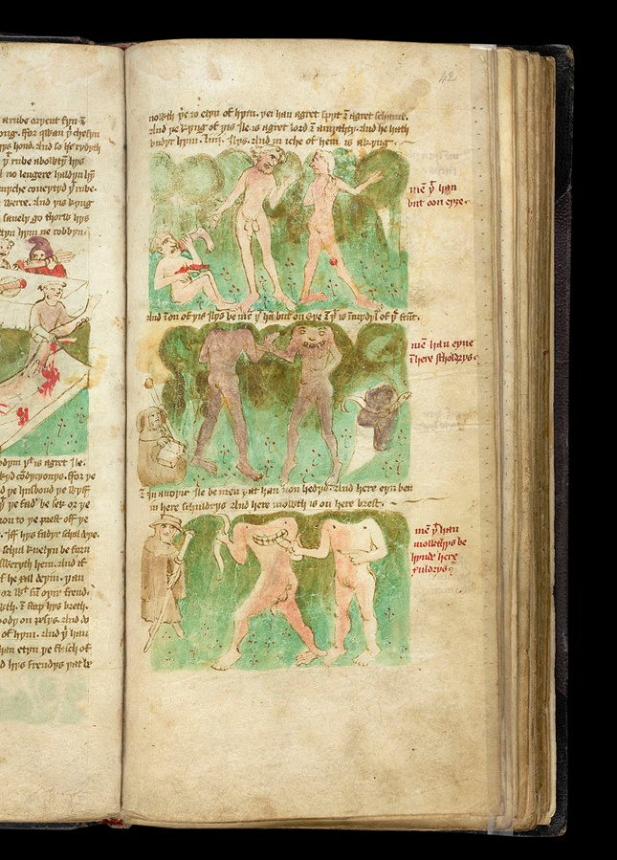
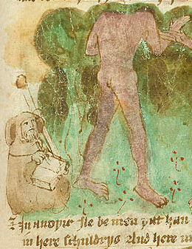
British Library, MS. Harley 3954. The Book of John Mandeville.
(now.)
Notes:
Now, I am able to access the images in the manuscript online—anytime, from my office at UofT. I can compare the images to other manuscripts of the Book of John Mandeville. I can study them, annotate them, put them in Powerpoints, and reference them robustly in scholarly arguments.

Slide 12
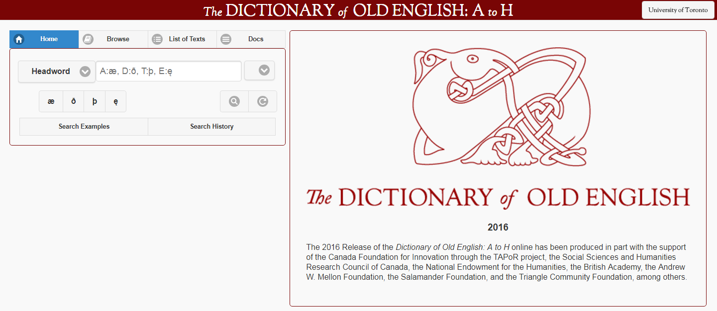
Dictionary of Old English

Slide 13
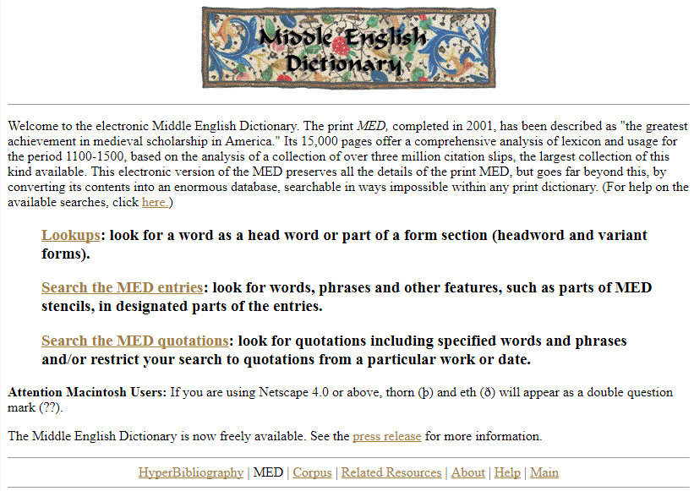
Middle English Dictionary

Slide 14
Analysis & Interpretation
Computational Analysis
Visualization
Annotation, Comparison, Close Reading

Slide 15
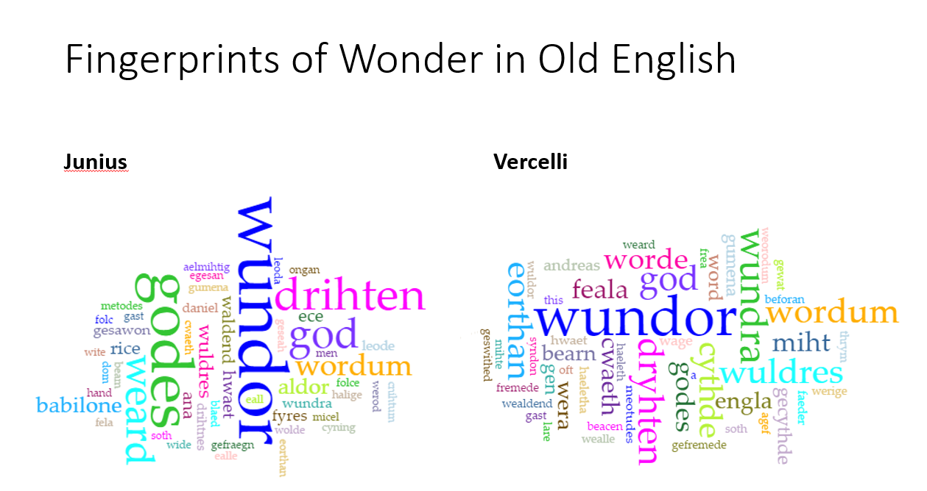
Andreas: 27
Elene: 28

Slide 16
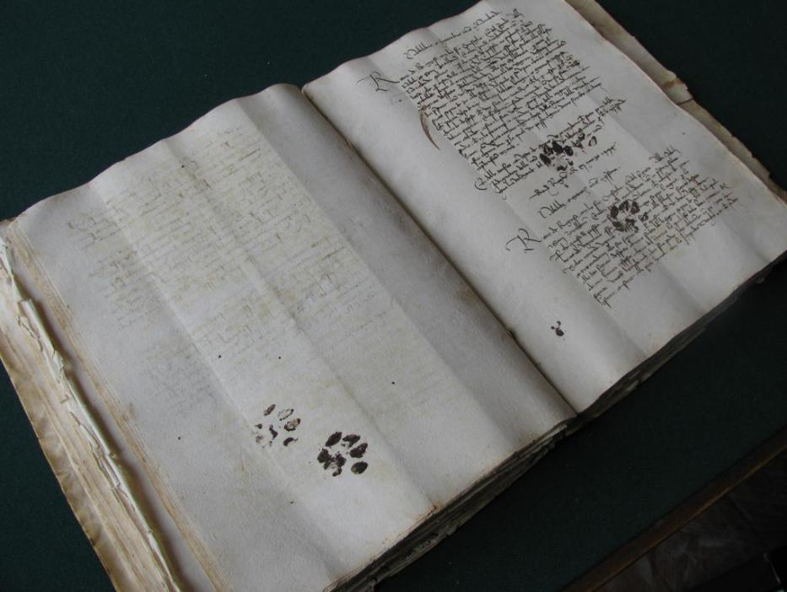
Research Materials: Medieval Manuscripts and Social Media
Cat paws in a fifteenth-century manuscript (photo taken at the Dubrovnik archives by @EmirOFilipovic, disseminated by Eric Kwakkel)

Slide 17
Humanities’ Data
Images & Maps
Sounds & Music
Films
Live or Digital Performances
Words, Languages, Grammars
Text
Social Media Archives

Slide 18
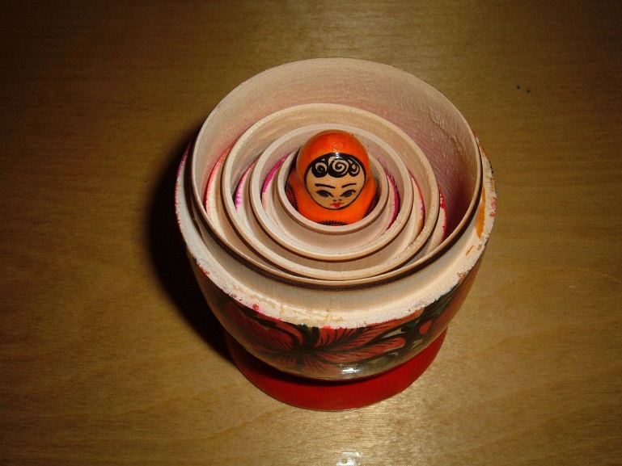
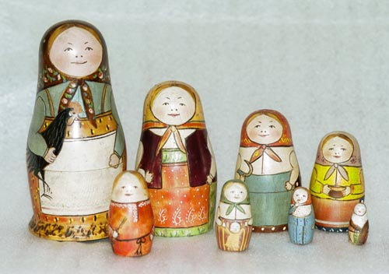
Humanities’ Data
Humanities’ data has depth in small universes. Our material has the capacity to unfold inwards, as it were, to disclose layer upon layer of insights and connections, within a comparatively tiny amount of data--almost an inverse matryoshka, as it were, where each inner doll is bigger and more complex than the one encasing it.
Photo: BrokenSphere - Own work, CC BY-SA 3.0, https://commons.wikimedia.org/w/index.php?curid=3773186
Doll carved by Zvezdochkin, painted by Malyutin - Sergiev Posad Museum of Toys, Russia, Public Domain, https://commons.wikimedia.org/w/index.php?curid=5051554

Slide 19
Data in Medieval Studies
Johanna Drucker:
Data = given
Capta = acquired/captured/constructed through interpretation

Slide 20
History

Slide 21
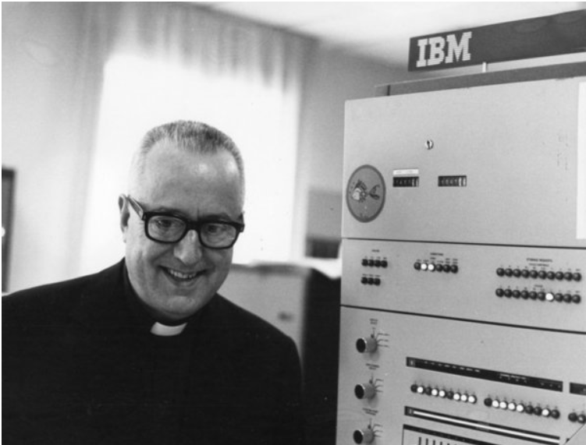
Father Roberto Busa, S. J. (1913-2011)
Index Thomisticus (1950s – 1980s; 2005 online)
11 million words of medieval Latin
30+ years of editing and analysis
8000+ hours of computer processing stacks of punch cards
1500 + km of magnetic tape
Father Roberto Busa with an IBM machine. (Stephen Ramsay, “Fr. Roberto Busa, S.J. (1913–2011),” stephenramsay.us/2011/08/11/father-roberto-busa/.

Slide 22
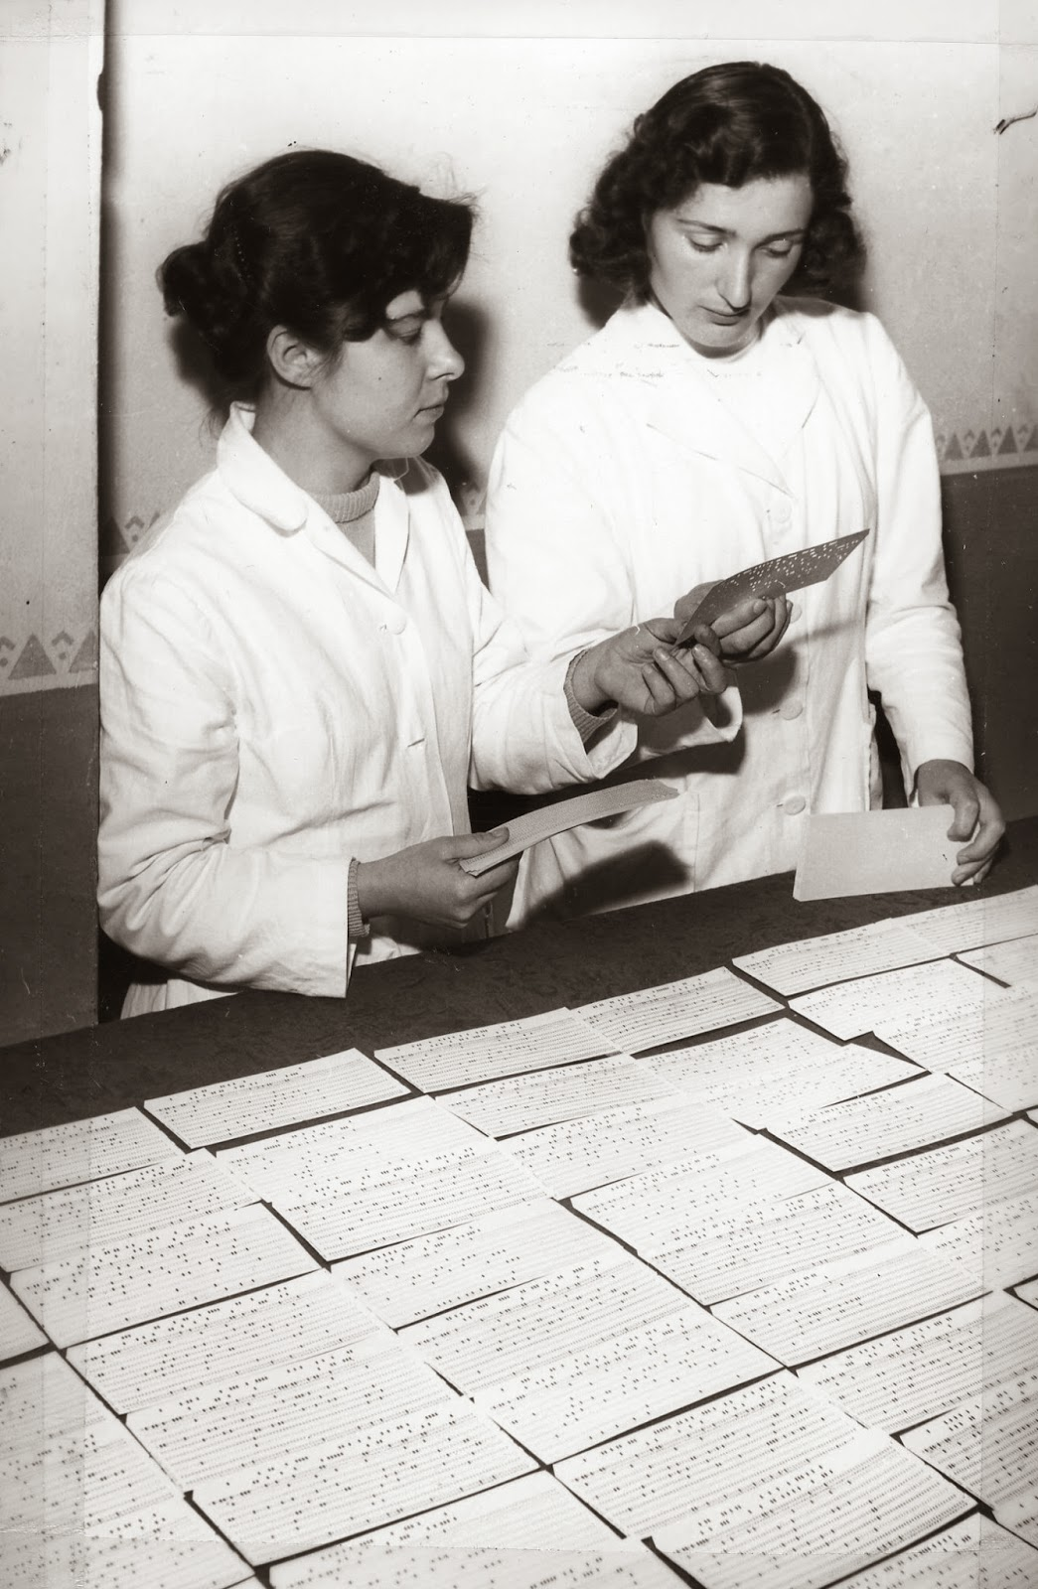
Father Busa’s Female Punch Card Operators. From Father Busa’s archive. CIRCSE Research Centre, Università Cattolica del Sacro Cuore, Milan, Italy. Featured by Melissa Terras, «For Ada Lovelace’s Day: Father Busa’s Female Punch Card Operators» (blog, 15 October 2013). Top left: Livia Canestraro.

Slide 23
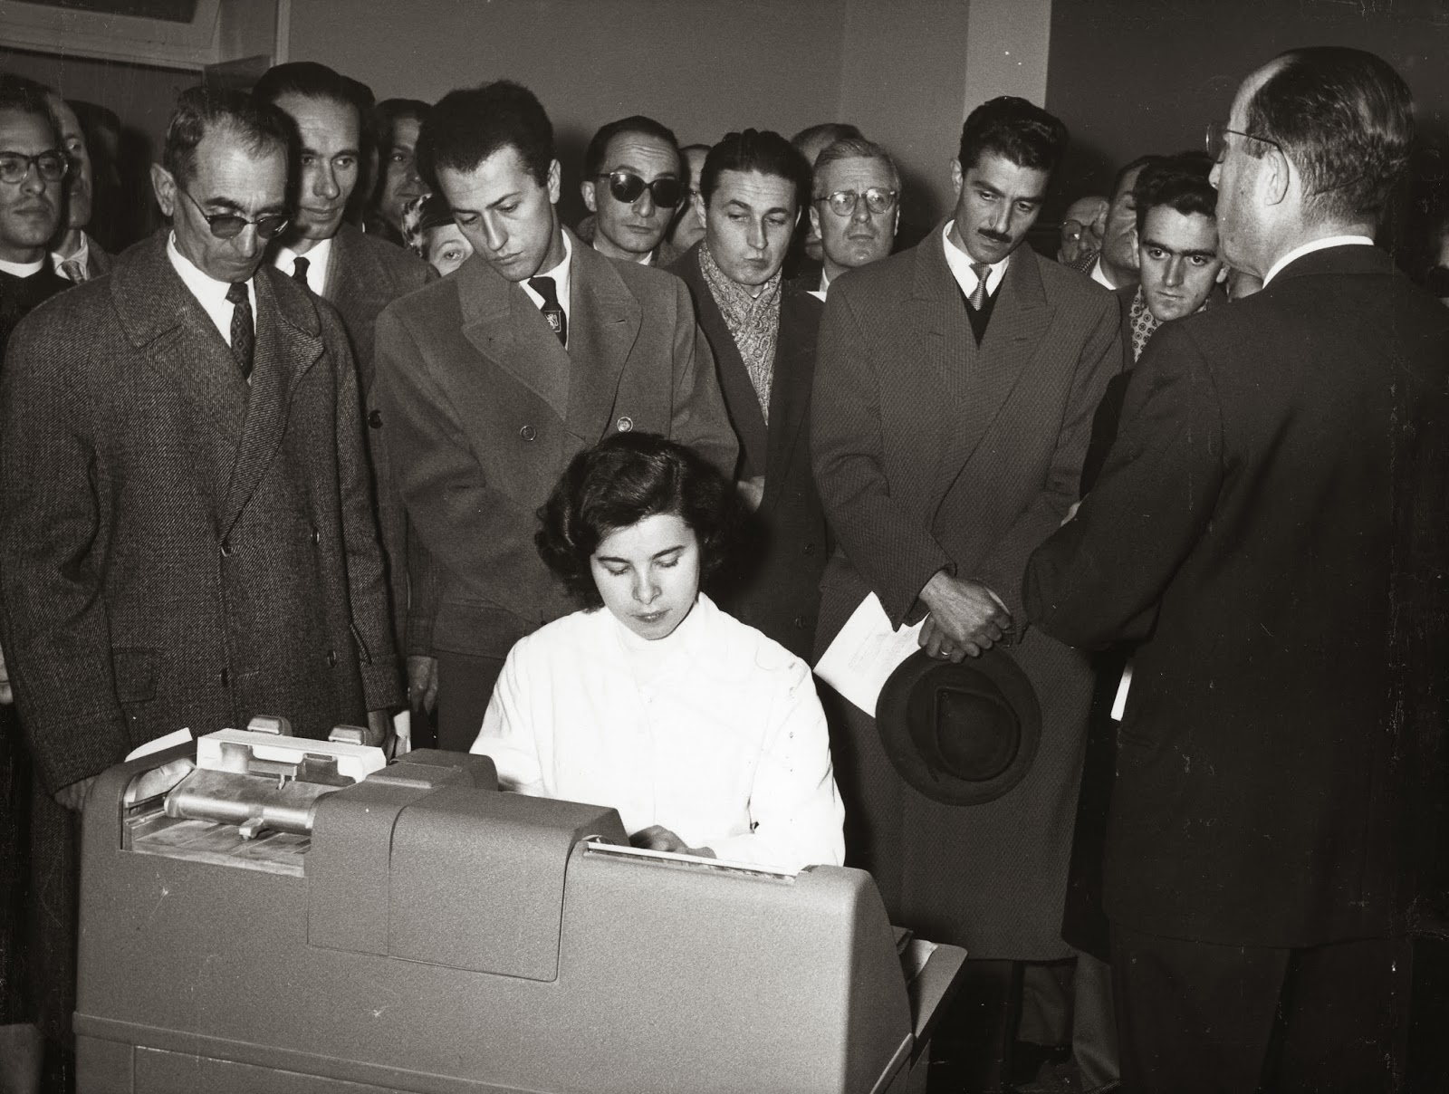
Father Busa’s Female Punch Card Operators. From Father Busa’s archive. CIRCSE Research Centre, Università Cattolica del Sacro Cuore, Milan, Italy. Featured by Melissa Terras, «For Ada Lovelace’s Day: Father Busa’s Female Punch Card Operators» (blog, 15 October 2013). Livia Canestraro.

Slide 24
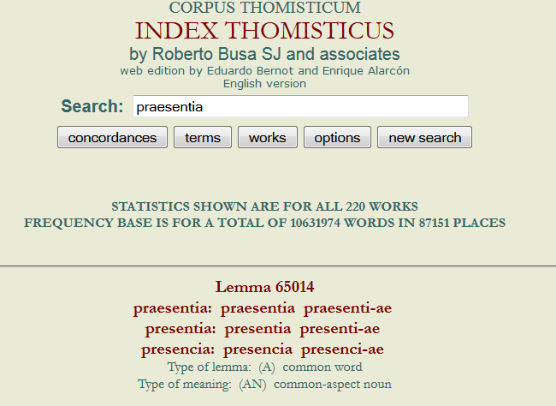
Father Busa and the Index Thomisticus

Slide 25
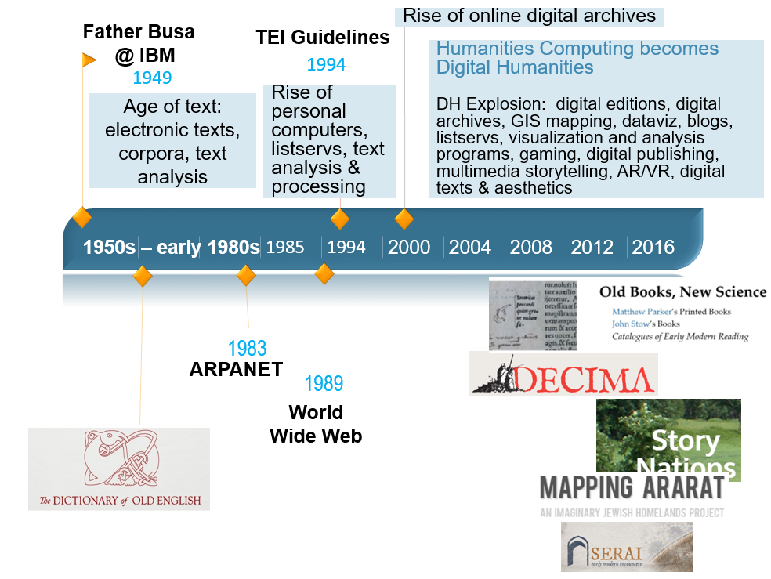
UofT DHN (Digital Humanities Network): 215+ members,
142 research
faculty

Slide 26
DH
Digital Maps
3D Imaging, Modelling, & Printing
Augmented & Virtual Reality
Text Corpora & Dictionaries
Digital Editions, Archives, and Narratives
Games, Storytelling, Digital Performance
Data Visualizations

Slide 27
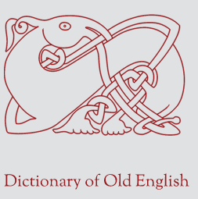
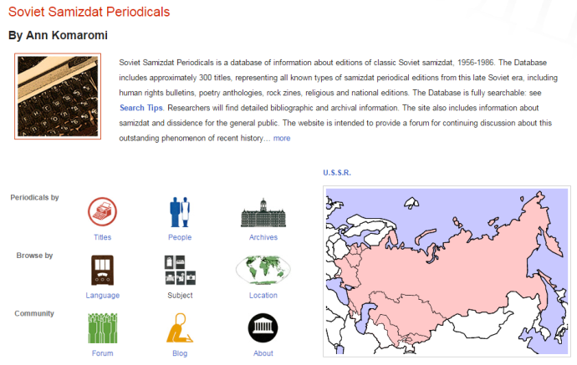
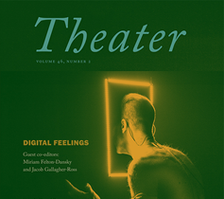
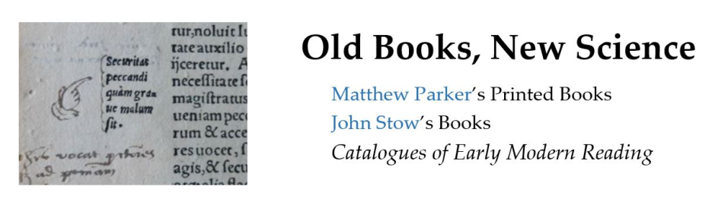

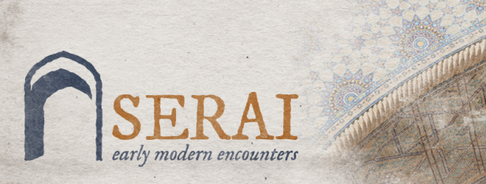
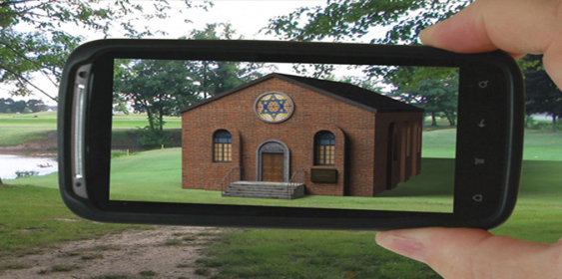
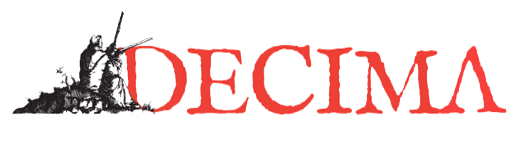
DH
Digital Maps
3D Imaging, Modelling, & Printing
Augmented & Virtual Reality
Text Corpora & Dictionaries
Digital Editions, Archives, & Narratives
Games, Storytelling, Performance

Slide 28
DH: Projects
Digital editing & narratives: making texts and narratives available digitally, allowing readers multimodal ways of accessing a text or a narrative (e.g. viewing transcribed text alongside manuscript of that text; or viewing a project that integrates curated artifacts, digital maps, and recorded interviews)
Data visualization: giving visual forms to data in order to explore and discern patterns, gain or illustrate insights
Digital archives: digital (or digitized) collections of primary documents about a place or a community; more broadly, collections of primary documents, e.g. manuscripts, books, letters, photographs, etc.
Digital mapping: plotting historical or literary data (urban economy, pilgrim routes, artifacts found at different archaeological sites, a character’s journey in a book) onto a modern, historical, or imaginary map
Augmented/virtual reality: using computing to overlay virtual elements onto real landscapes (AR), or using computing tech to simulate an immersive, interactive, three-dimensional virtual environment
3D printing: turning a digital model into a real object through additive manufacturing (delicate layering of plastic via 3D printer machine)
Storytelling & performance: video games, coding as art practice

Slide 29
Digital Editions, Archives, Narratives

Slide 30
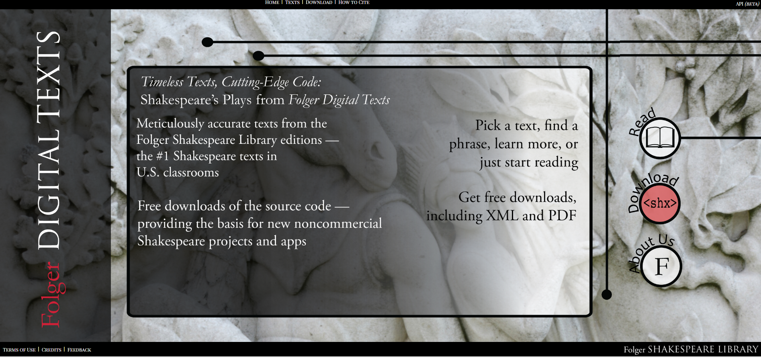
Folger: Shakespeare Library

Slide 31
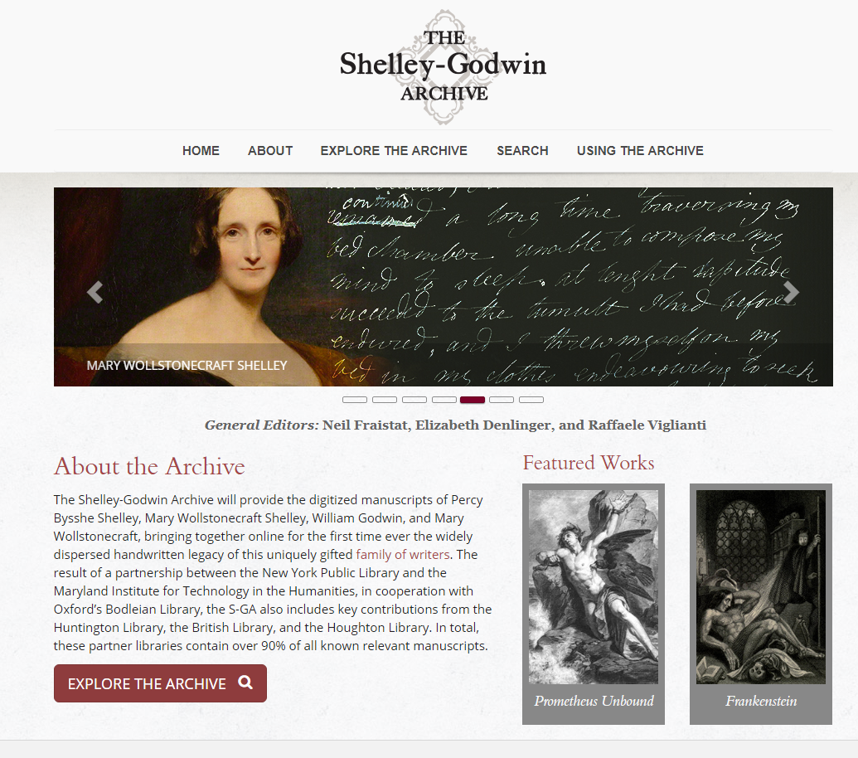
Shelley-Godwin Archive

Slide 32
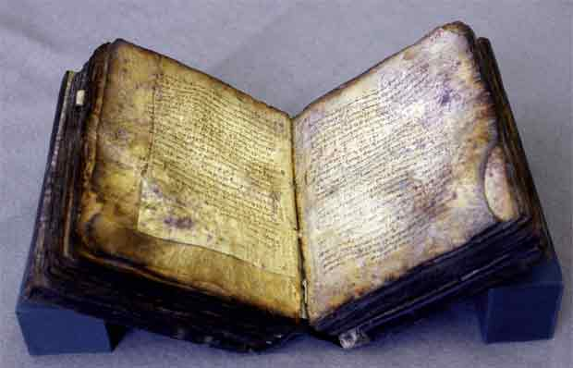
The Archimedes Palimpsest: Multispectral Imaging

Slide 33
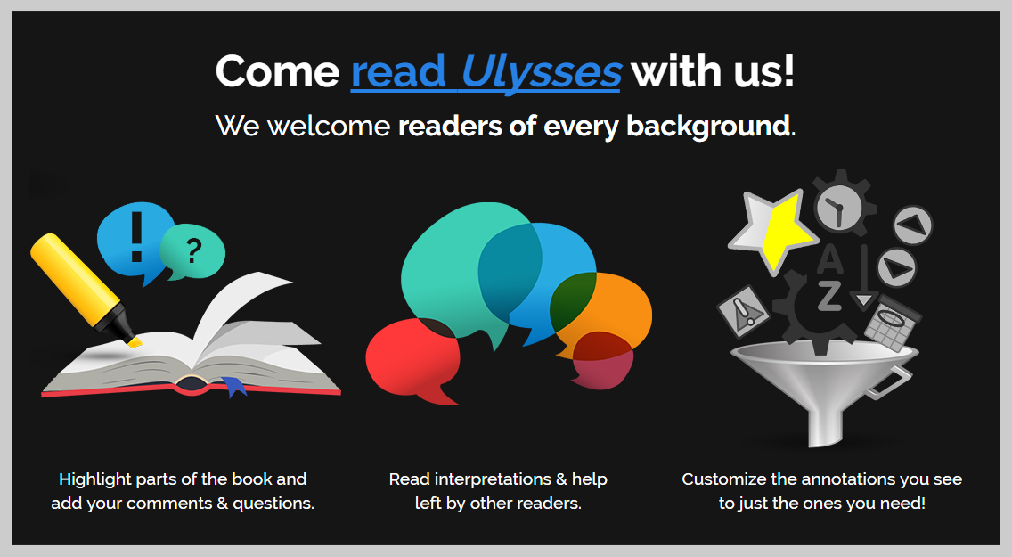
Infinite Ulysses: interactive reader’s edition by Amanda Visconti

Slide 34
Maps, Visualizations, Interpretations

Slide 35
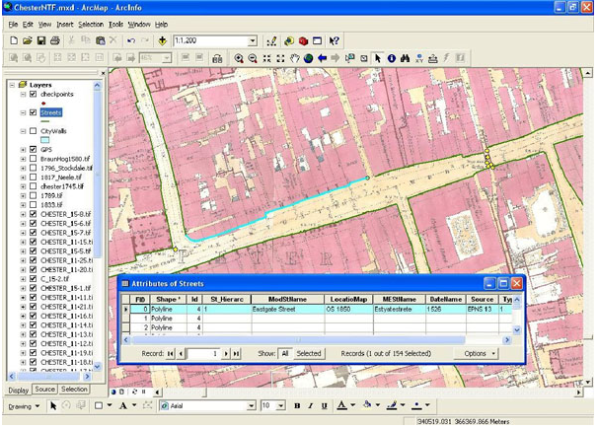
Mapping Medieval Chester
Goal: making a digital map of medieval Chester by combining post-medieval maps with archaeological and historical evidence
Digital advantage: interactive, layered, & transparent

Slide 36
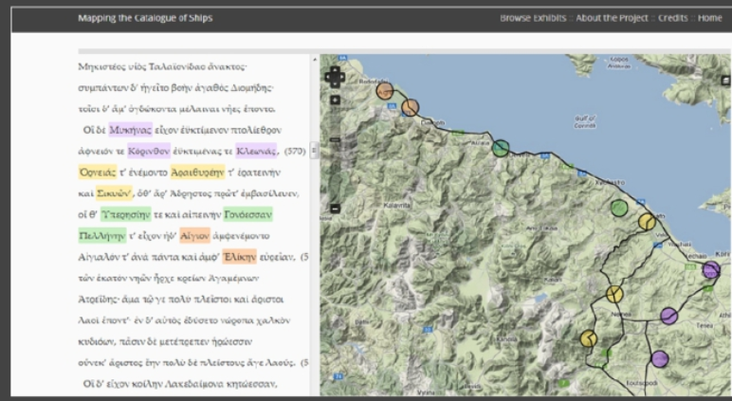
Mapping Homer’s Catalogue of Ships
Courtney Evans and Ben Jasnow, with Jenny Strauss Clay and the UVA Scholars’ Lab (2013)
Mapping the towns in Homer’s Catalogue of Ships to analyze underlying organizing principles for the narration

Slide 37
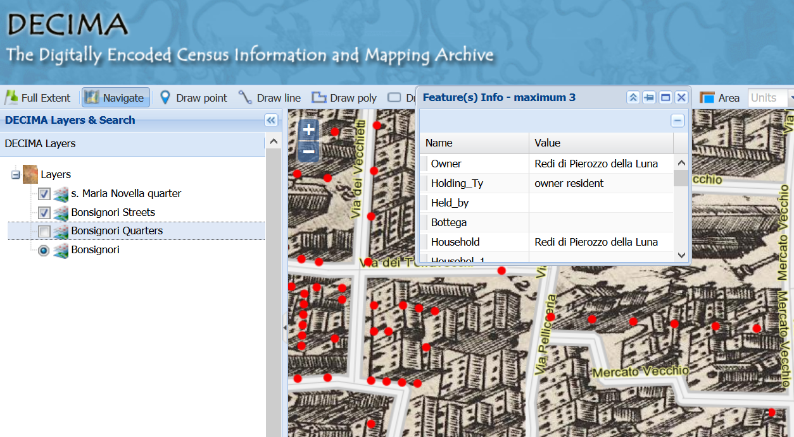
Project DECIMA
University of Toronto, History Dept.
Onto a 16th century map of Florence, DECIMA maps census data about Florence’s inhabitants, their occupations, wealth, and daily life.

Slide 38
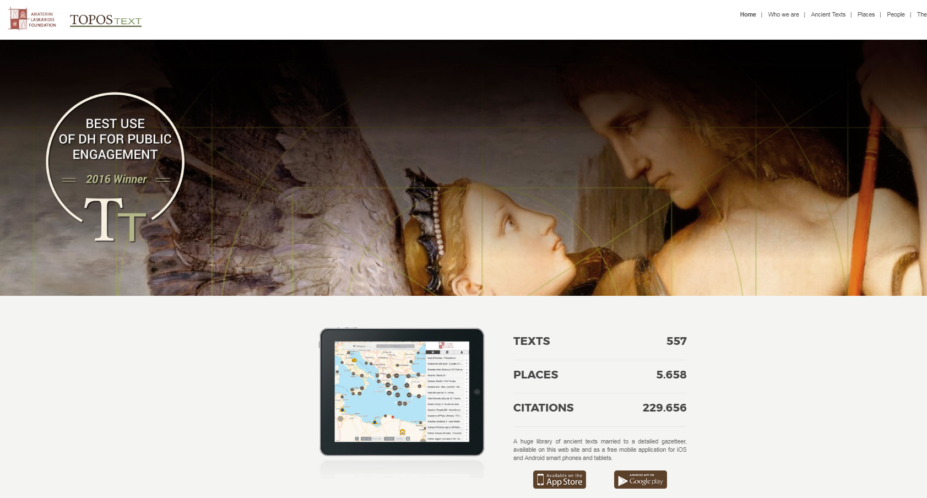
ToposText: Ancient Texts + Maps

Slide 39
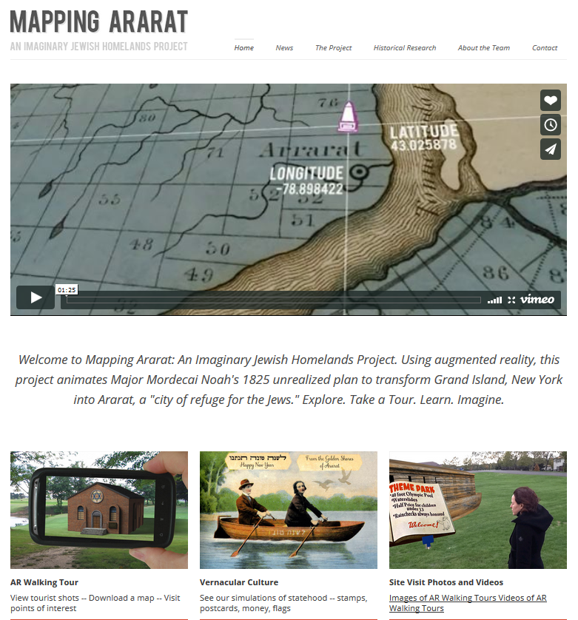
Mapping Ararat

Slide 40
Communication
Scholarly Writings, Public Engagement, Social Media, Teaching & Collaboration

Slide 41
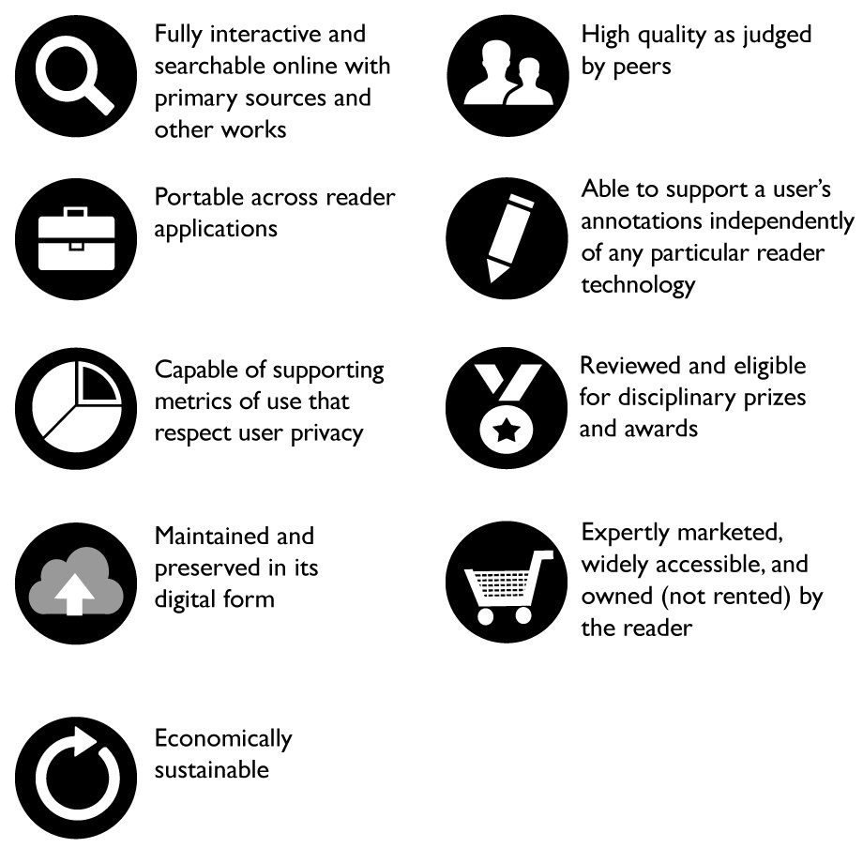
Scholarly Books: The Networked Monograph
In addition to printed books, can scholarly monographs expand their forms to “take advantage […] of the interactive, annotative, and computational affordances of the web”? Donald J. Waters, “Monograph Publishing in the Digital Age” (2016)
Digitally augmented scholarly monographs (e.g. Mellon-funded collaboration between NYU Library and NYU Press)

Slide 42
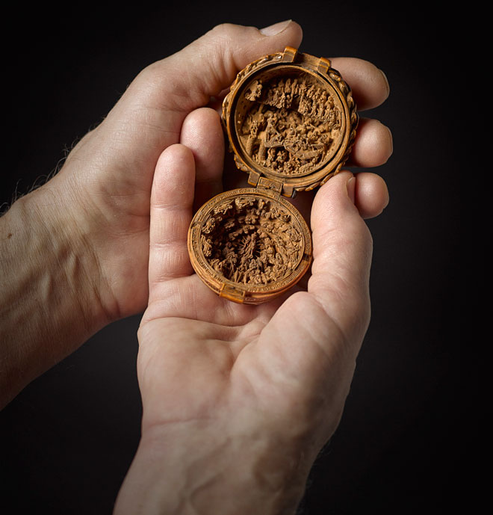
VR/3D Printing for Cultural Heritage Collections: Small Wonders (AGO)
Miniature boxwood carvings from the early 1500s
Studied and exhibited through digital imaging (micro CAT scanning), VR, and 3D printing

Slide 43
Research Materials: Medieval Manuscripts and Social Media
Cat paws in a fifteenth-century manuscript (photo taken at the Dubrovnik archives by @EmirOFilipovic, disseminated by Eric Kwakkel)

Slide 44
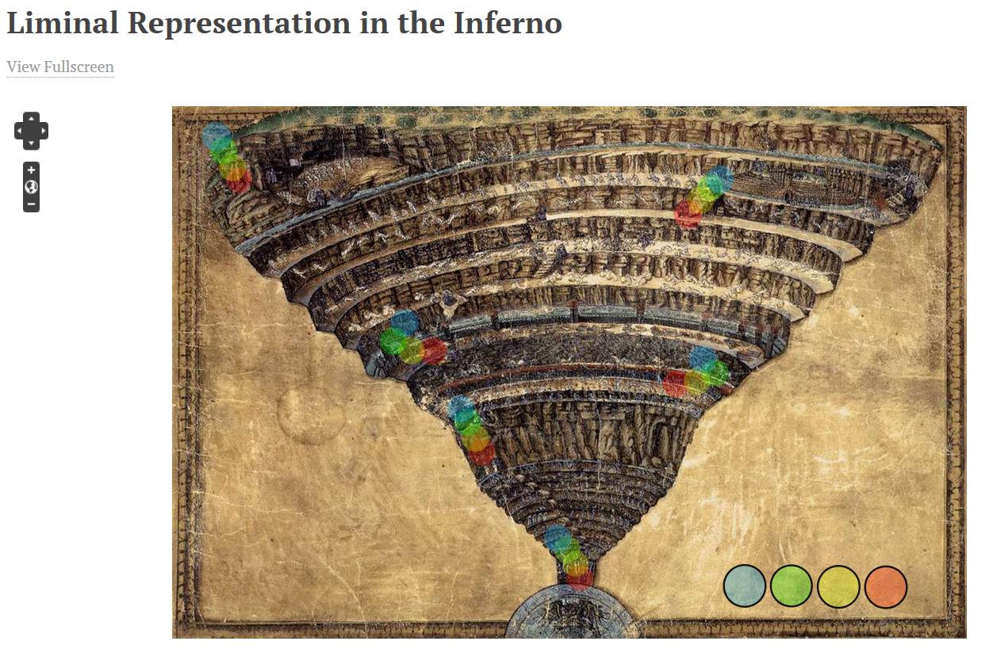
Teaching
Heather Eason: five artists' representations of threshold crossings in Dante's Inferno. Omeka/Neatline undergraduate student project.
Notes:
Heather Eason: five artists' representations of threshold crossings in Dante's Inferno--the unknown illustrator of the fourteenth-century MS Holkham misc. 48; Priamo della Quercia of the fifteenth-century Yates Thompson MS 36; Gustave Doré; Salvador Dalí; and Dante himself.

Slide 45
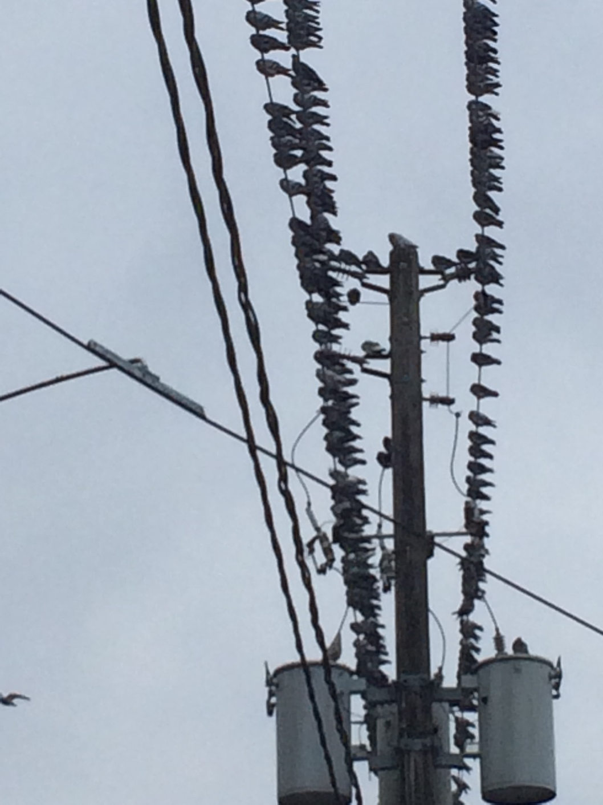
Collaboration & Infrastructures
Pigeons at Bathurst subway station. Photo: AB.

Slide 46
Course Syllabus

